Slide 1
Introduction to Machine Learning and Control for Building Energy Systems
Ján Drgoňa
Associate Professor @ CaSE & ROSEI

Slide 2
Course Syllabus
Week 1: Introduction to Building Energy Systems
Week 2: HVAC systems and heat transfer modeling
Week 3: Dynamical systems fundamentals
Week 4: Control systems fundamentals
Week 5: Machine learning fundamentals - with HVAC load forecasting example
Week 6: System identification - with thermal dynamics modeling example
Week 7: Constrained optimization fundamentals
Week 8: Optimal control fundamentals
Week 9: Model predictive control of building energy systems
Week 10: Practical implementation aspects and high-fidelity building emulators
Week 11: Project evaluation with presentations

Slide 3
Grading and Course Expectations
Participation 10%
Homework 30% - week 3-5
Project proposal 10% - week 6
Project progress report 10% - week 8
Project final report 20% - week 10
Project presentation 20% - week 11

Slide 4

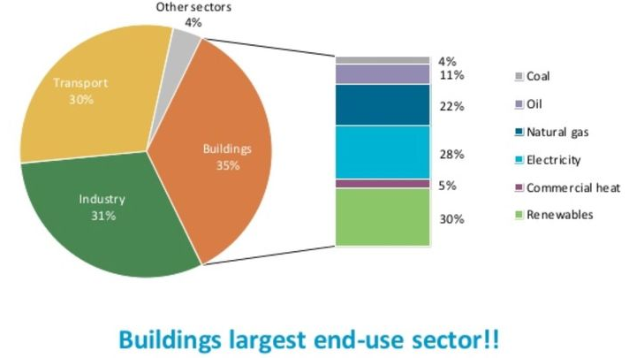

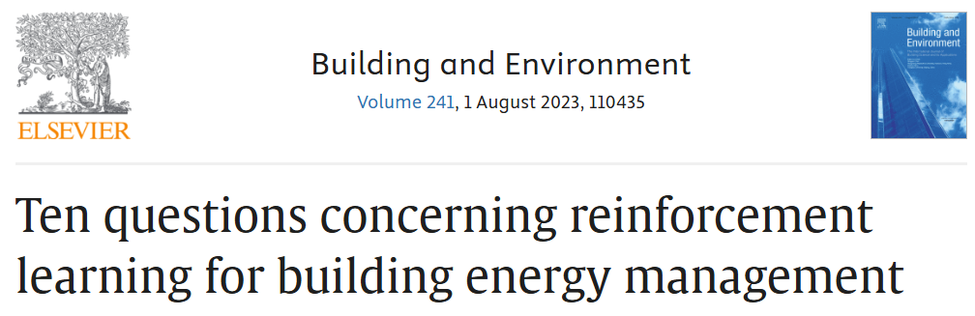
Motivation
Advanced modeling and control methods can notably reduce energy use and mitigate GHG emissions of building with average energy savings of 13% to 28%.
However, there are significant barriers when it comes to technology adoption in practice.
International Energy Agency (IEA), Energy Technology Perspectives 2014 https://www.iea.org/reports/energy-technology-perspectives-2014
Notes:
Out motivation starts with the impact the modern buildings have on global energy and climate. Our Ambition was to provide Unifying framework integrating both theoretical and practical aspects of the technology
Single publication for guiding the whole process of implementation of MPC in real buildings

Slide 5
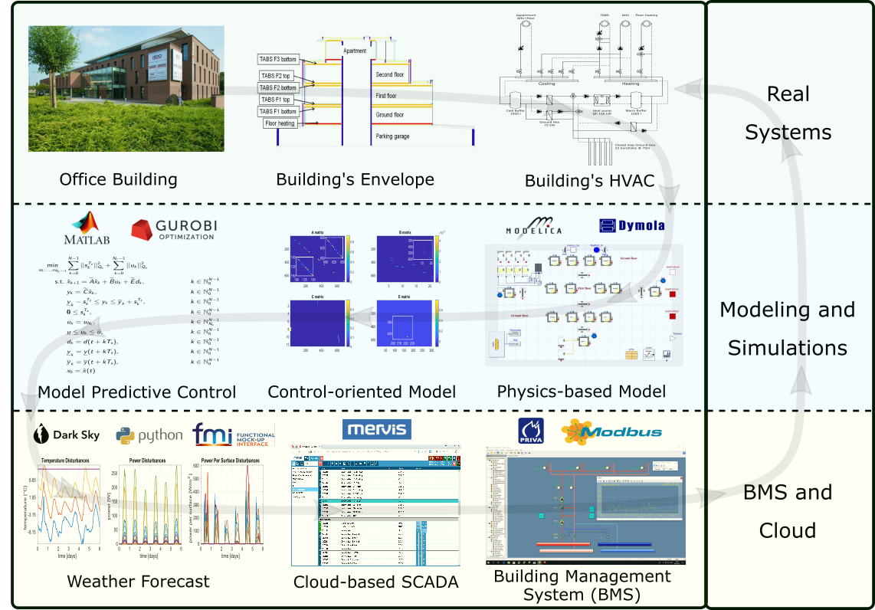
Practical Implementation Example of Machine Learning and Optimal Control in a Real-World Building
Real-world case study with 50% energy savings and close to 40% thermal comfort improvement.
Involved integration of dynamical systems modeling, machine learning, and optimal control methods.
Real-time operation enabled via cloud-based solution.
Drgona J., et al., Cloud-based implementation of white-box model predictive control for a GEOTABS office building: a field test demonstration. Journal of Process Control, 2019.
Notes:
To better understand the complexity of the task, lets walk through a complete workflow as implemented for a practical use case to control an office building in Belgium.
This office building is equipped with thermally activated building structures with a geothermal heat pump (GEOTABS). These kinds of buildings are known to be very challenging to control due to the large thermal mass and associated time delays. For optimal operation of this type of systems, predictive control is an absolute must.
First one develops a high-fidelity physics-based model based on the available engineering documentation and measurement data.
Then the control-relevant equations are extracted and used to construct an optimization-based predictive controller.
The optimized controls are computed every 15min based on new weather forecast and new measurement from the building, then the controls are communicated to the building management system for execution.
The whole procedure takes approximately a minute to execute in real time.
After using the MPC in the office building for a couple of months the team measured more than 50% energy savings on the heat pump and improved thermal comfort by approximately 37%. The rigid and delayed behavior of the rule-based controller is replaced by dynamic and anticipatory behavior of MPC, which keeps the zone temperatures closer within comfort bounds and delivers cooling only when it is needed.

Slide 6
Practical Implementation Example of Machine Learning and Optimal Control in a Real-World Building
Focus of this Course.
Drgona J., et al., Cloud-based implementation of white-box model predictive control for a GEOTABS office building: a field test demonstration. Journal of Process Control, 2019.
Notes:
To better understand the complexity of the task, lets walk through a complete workflow as implemented for a practical use case to control an office building in Belgium.
This office building is equipped with thermally activated building structures with a geothermal heat pump (GEOTABS). These kinds of buildings are known to be very challenging to control due to the large thermal mass and associated time delays. For optimal operation of this type of systems, predictive control is an absolute must.
First one develops a high-fidelity physics-based model based on the available engineering documentation and measurement data.
Then the control-relevant equations are extracted and used to construct an optimization-based predictive controller.
The optimized controls are computed every 15min based on new weather forecast and new measurement from the building, then the controls are communicated to the building management system for execution.
The whole procedure takes approximately a minute to execute in real time.
After using the MPC in the office building for a couple of months the team measured more than 50% energy savings on the heat pump and improved thermal comfort by approximately 37%. The rigid and delayed behavior of the rule-based controller is replaced by dynamic and anticipatory behavior of MPC, which keeps the zone temperatures closer within comfort bounds and delivers cooling only when it is needed.

Slide 7
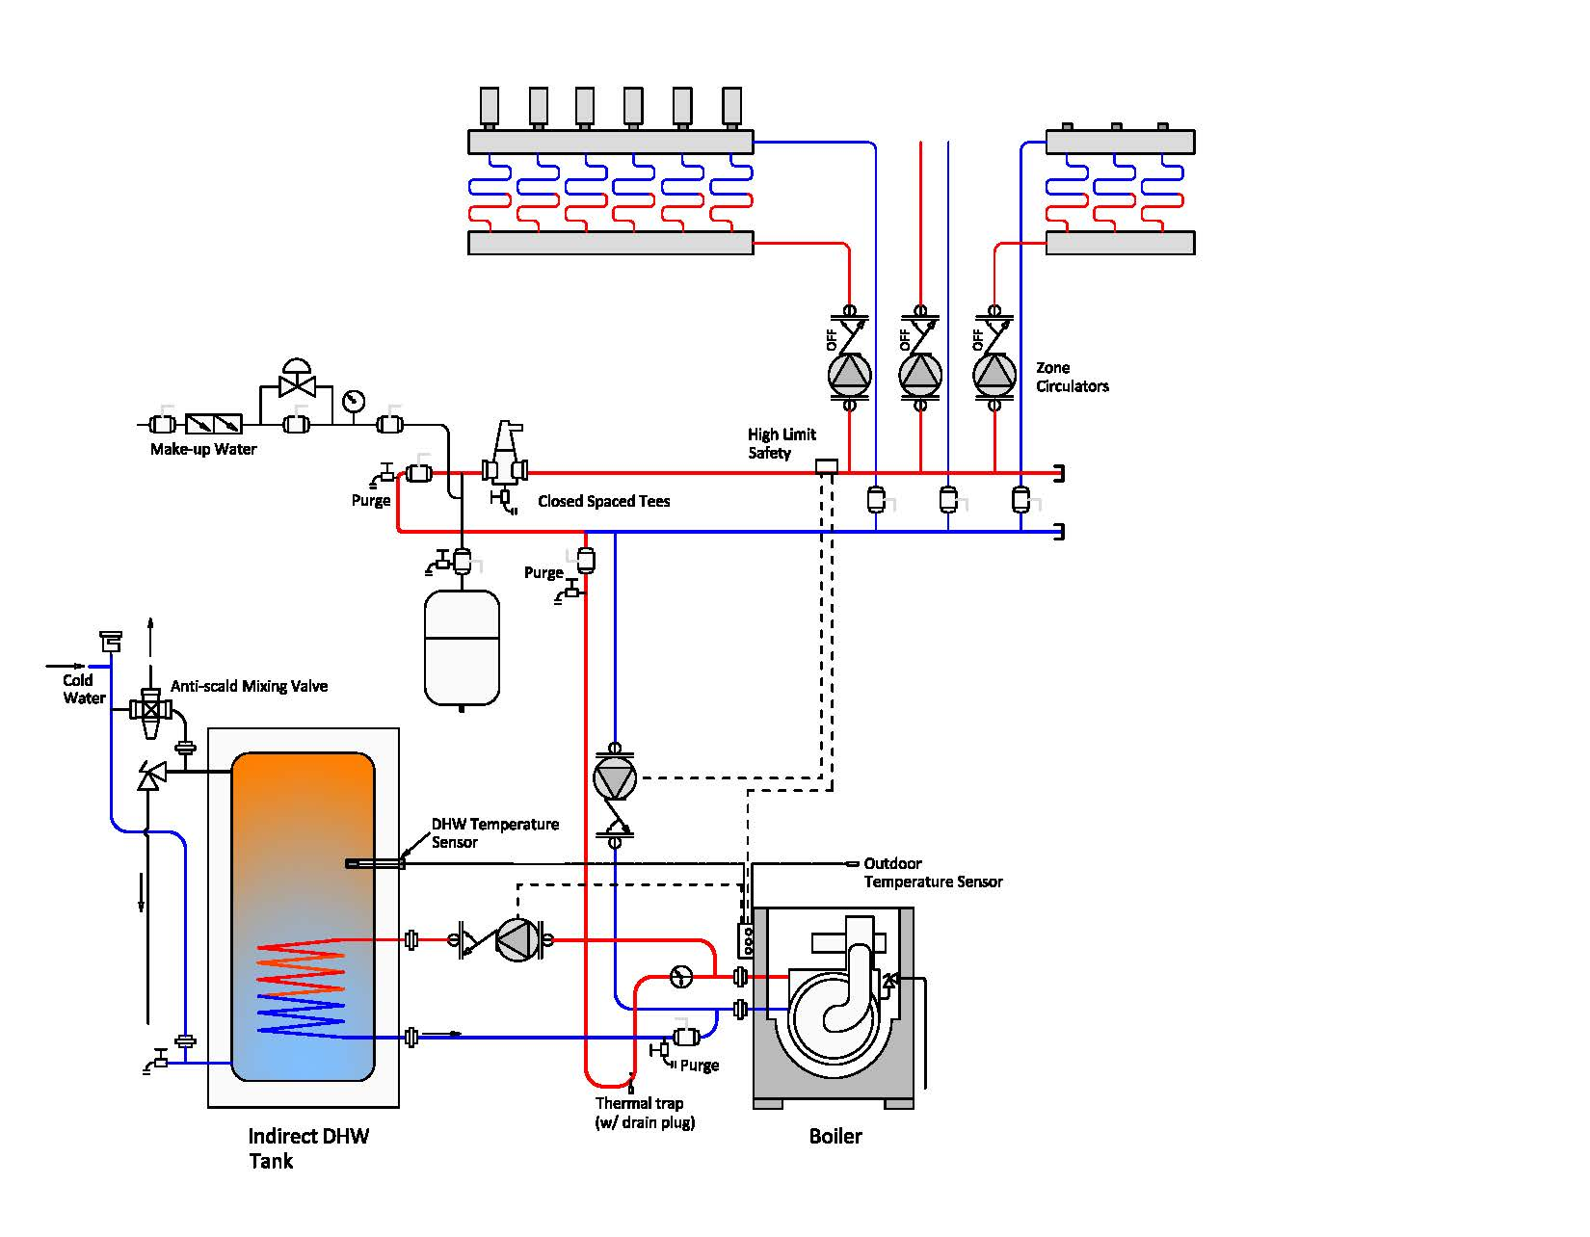
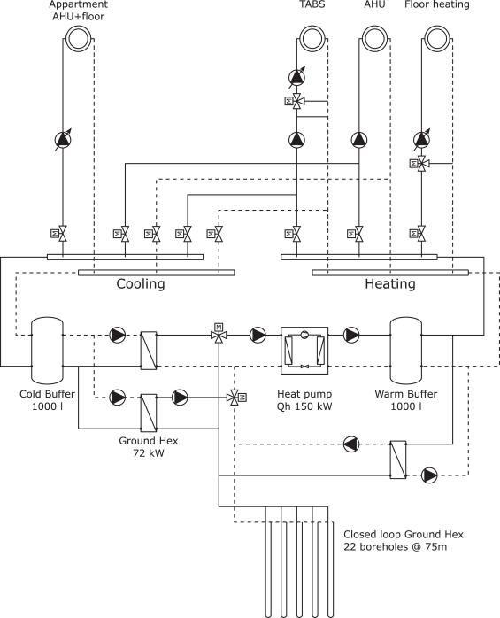
Week 2: Heating Ventilation and Air Conditioning (HVAC) Systems
Example of an HVAC system in a residential building
Example of an HVAC system in an office building
Drgona J., et al., Cloud-based implementation of white-box model predictive control for a GEOTABS office building: a field test demonstration. Journal of Process Control, 2019.
Image sourced from https://basc.pnnl.gov/images/

Slide 8

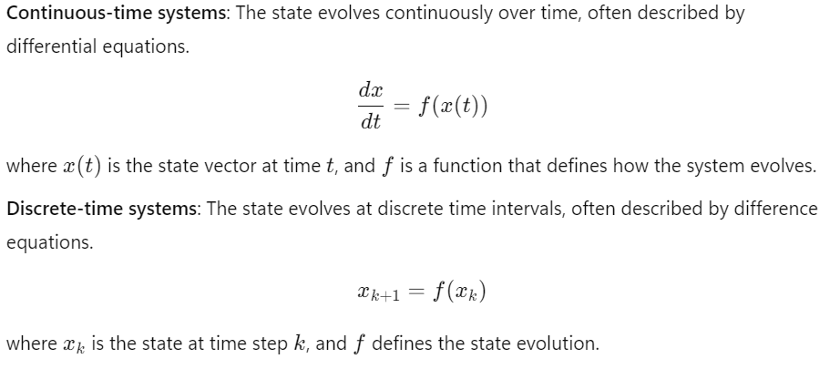
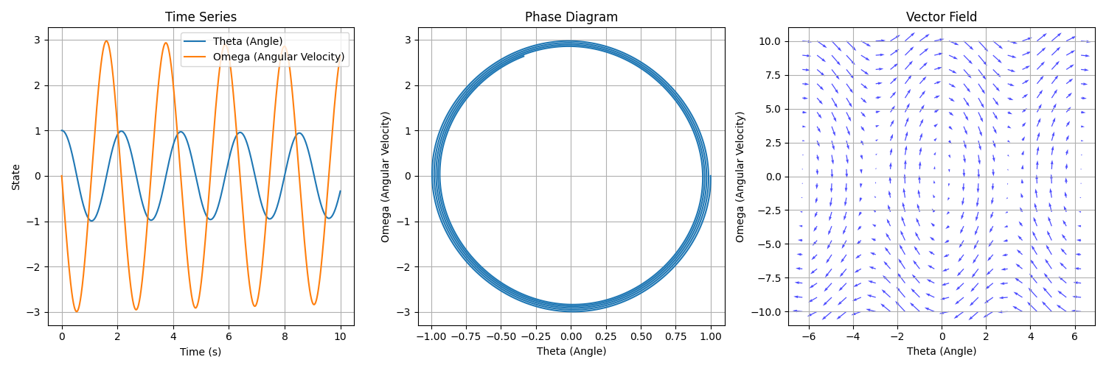
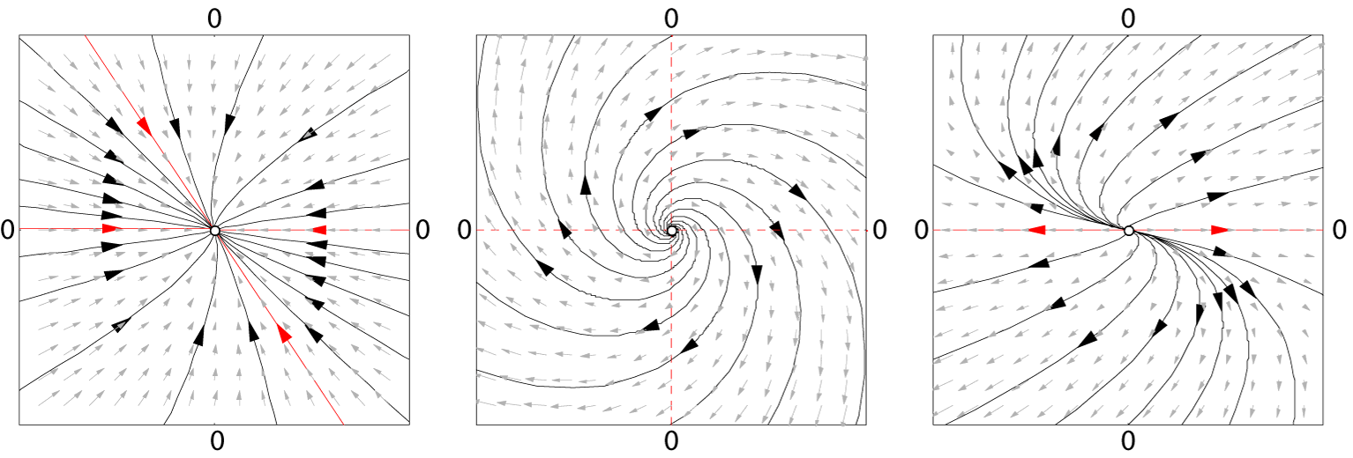
Week 3: Dynamical Systems Fundamentals
Phase space diagrams
Stability analysis
Time series
Vector fields

Slide 9
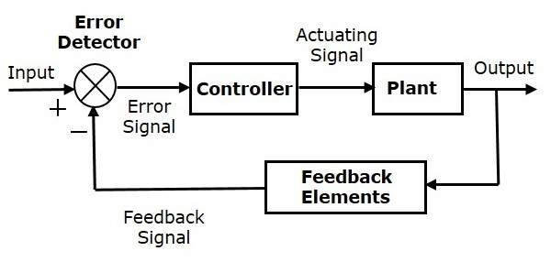
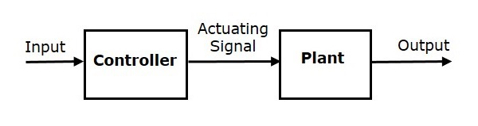
Week 4: Control Systems Fundamentals
Open-loop control system:
Closed-loop control system:
Control Methods:
Proportional Integral Derivative (PID)
Linear Quadratic Regulator (LQR)
Model Predictive Control (MPC)
Reinforcement Learning (RL)
Adaptive control
Robust control
Fuzzy logic control
Dynamical System/Plant Models:
Transfer functions
Transfer matrices
State space models (Difference equations)
Differential equations
Machine learning models
https://en.wikibooks.org/wiki/Control_Systems https://www.tutorialspoint.com/control_systems/index.htm

Slide 10
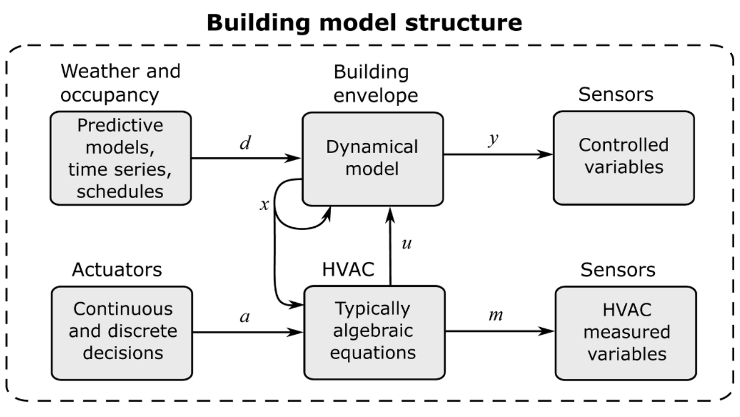
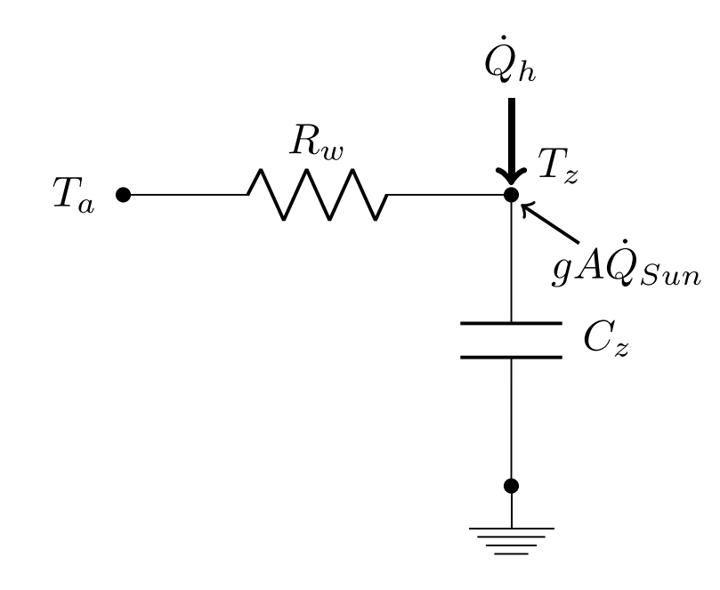
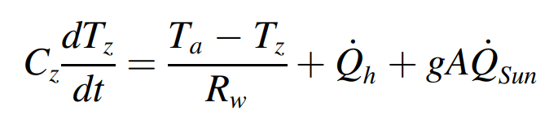
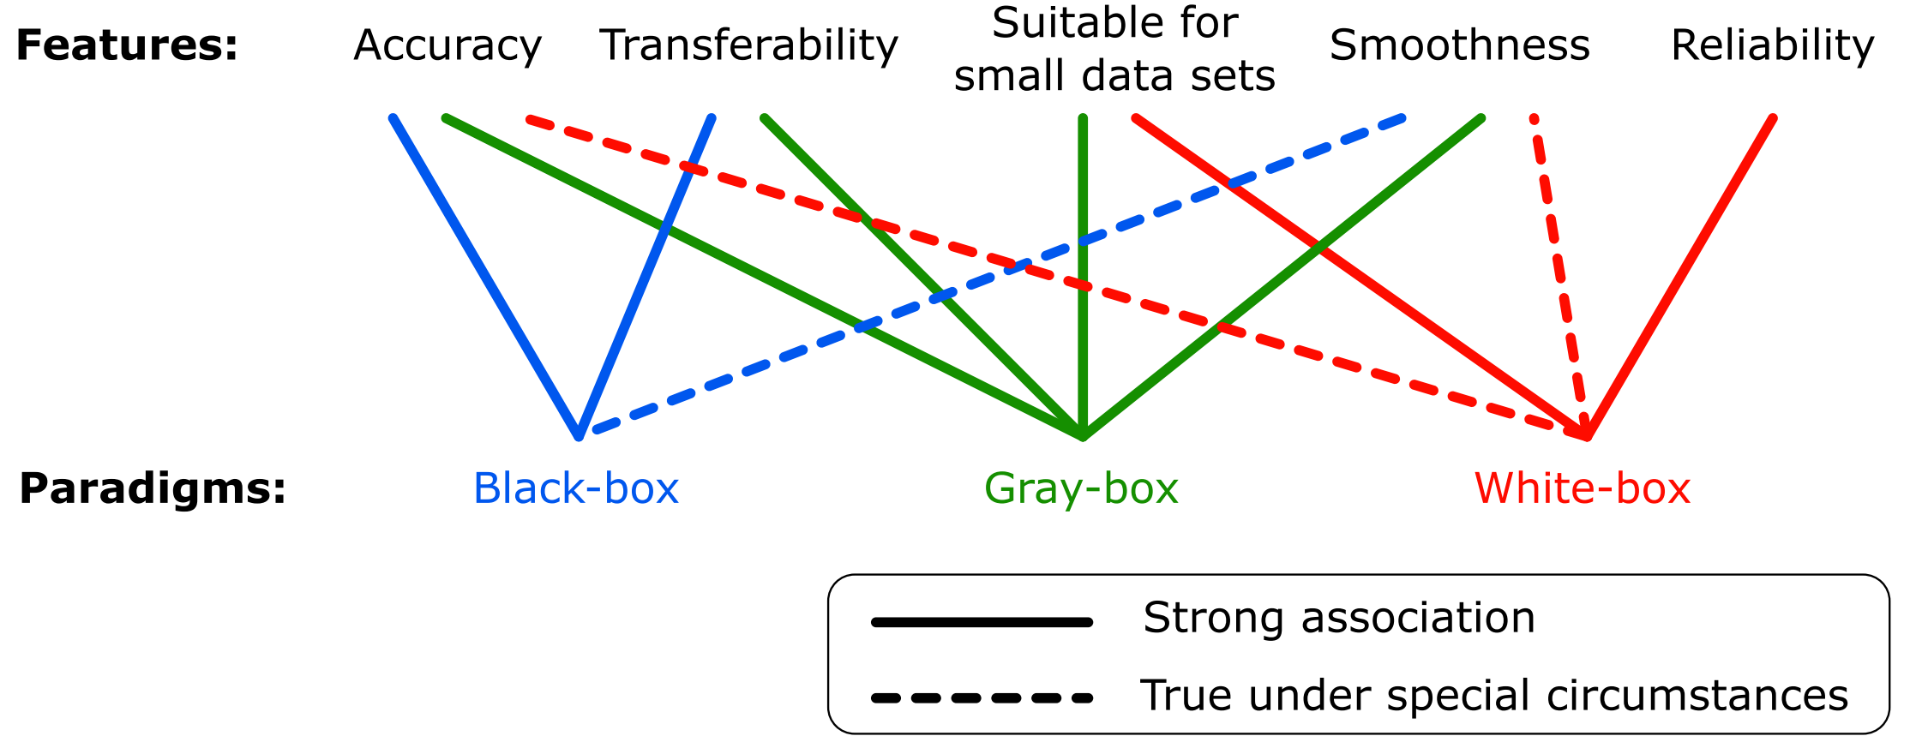
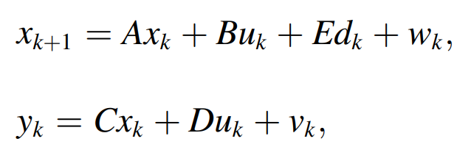
Week 5: System Identification of Building Energy Systems
Diagrams:
Differential Equations:
State space models:
Ján Drgoňa, et al., All you need to know about model predictive control for buildings, Annual Reviews in Control, 2020
Notes:
Core component of MPC: models of building physics/thermal dynamics – its development is also one of the main bottlenecks
MPC performance depends on model accuracy and reliability
Sound tradeoff between model accuracy and simplicity is required for MPC solvers
In our paper we review and compare different modeling paradigms: black gray and white box approaches we provide complete modeling framework starting with real building -> equipment components -> eng. diagrams -> physics equations -> control oriented models

Slide 11
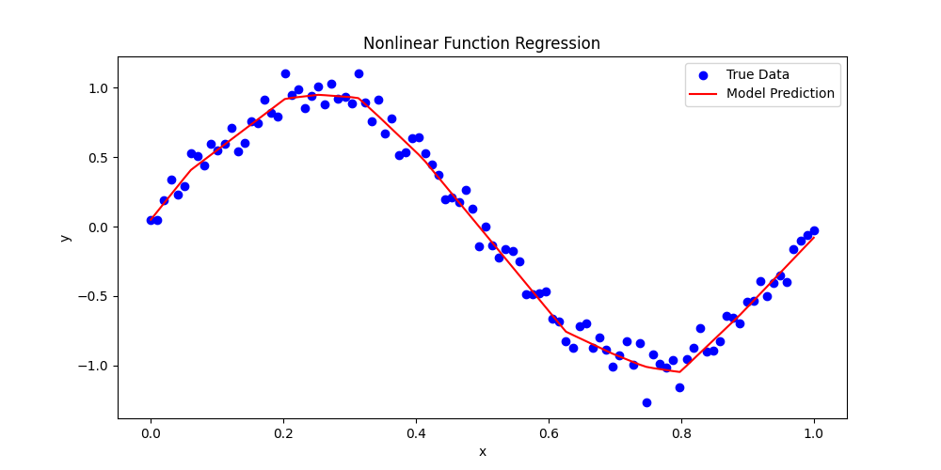
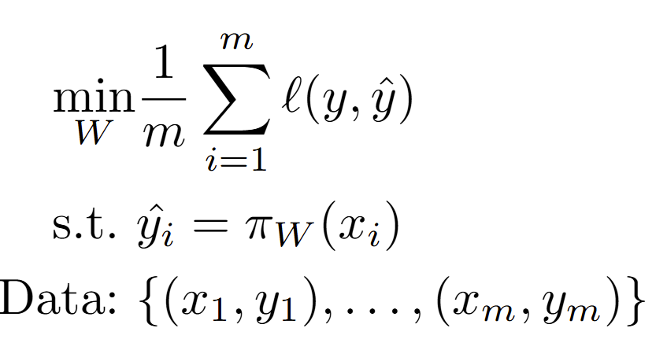
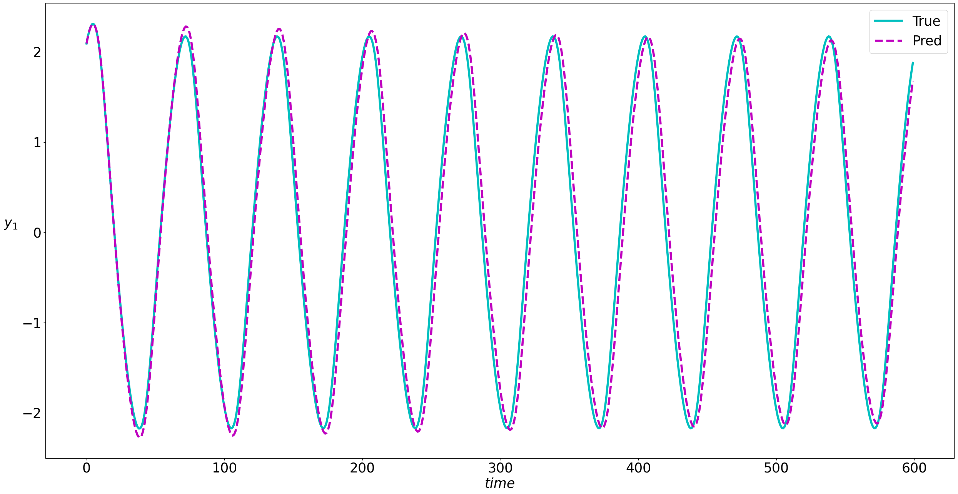
Week 6: Machine Learning Fundamentals
Machine Learning (ML) is focused on building systems that learn from data and improve performance without being explicitly programmed. It enables to identify patterns, make predictions, and adapt to new information.
Supervised machine learning problem formulation:
Objective function types:
Regression
Classification
Model types:
Linear
Neural networks
Tree-based models
Kernel methods
https://www.coursera.org/learn/machine-learning
"Deep Learning" by Ian Goodfellow, Yoshua Bengio, and Aaron Courville "Mathematics for Machine Learning" by Marc Peter Deisenroth, A. Aldo Faisal, and Cheng Soon Ong

Slide 12

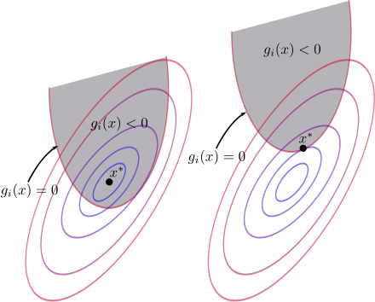
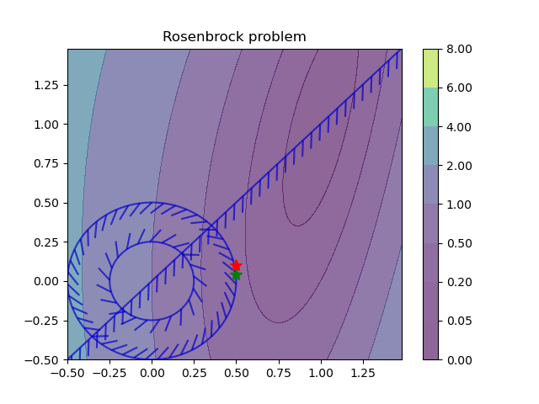
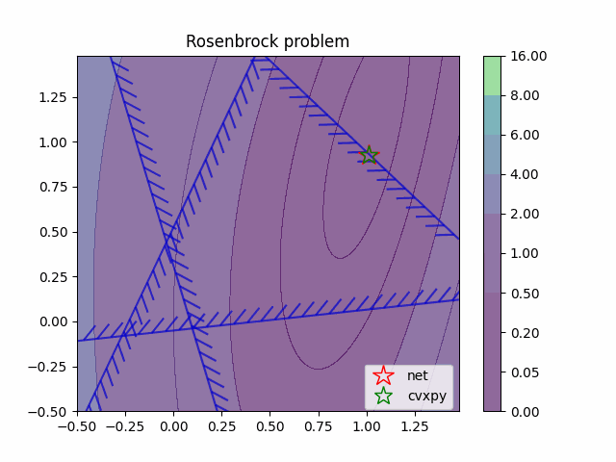
Week 7: Constrained Optimization Fundamentals
Constrained optimization (CO) is a mathematical framework for solving problems where the objective function must be optimized (minimized or maximized) subject to certain constraints. These constraints could be equalities or inequalities.
CO problem formulation:
CO problem types:
Linear
Quadratic
Nonlinear
Integer (Combinatorial)
Mixed-integer
CO solution methods:
Lagrange Multipliers
Karush-Kuhn-Tucker (KKT) conditions
Penalty and Barrier Methods
Sequential quadratic prohramming
Interior point methods
S. Boyd and L. Vandenberghe, ”Convex optimization,” Cambridge University Press, 2004. https://web.stanford.edu/~boyd/cvxbook/

Slide 13
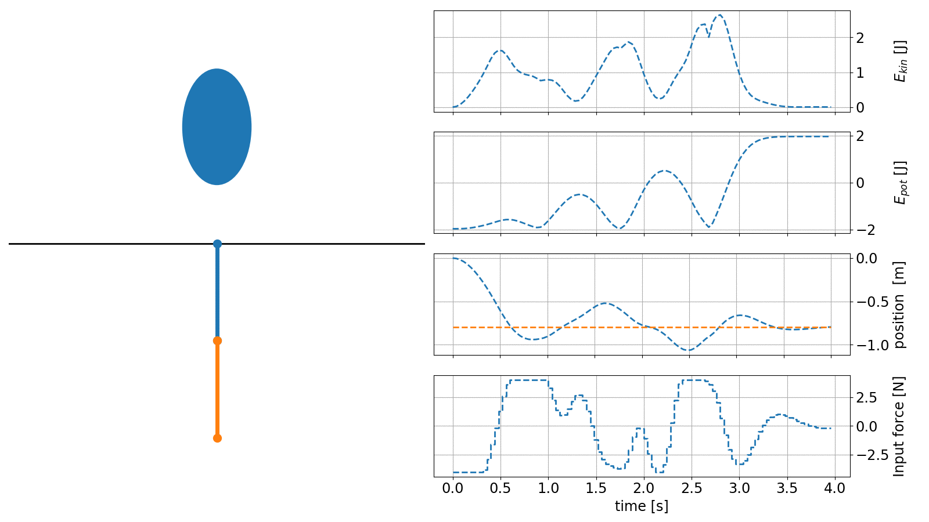
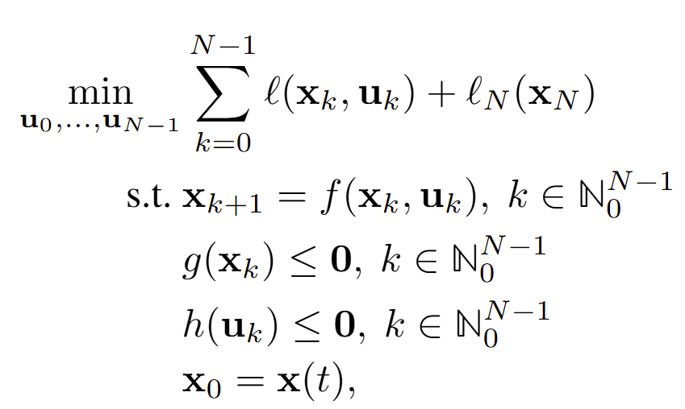
Week 8: Optimal Control Fundamentals
Optimal control is a branch of control theory concerned with finding control inputs that optimize a performance criterion while satisfying system dynamics and constraints. It plays a crucial role in applications like robotics, aerospace, economics, and energy systems.
Optimal control problem formulation:
Finite horizon cost function + terminal penalty
System dynamics model
State constraints
Input constraints
Initial conditions
Bertsekas, D. P. (1995). Dynamic Programming and Optimal Control. Belmont: Athena. ISBN 1-886529-11-6.
James B. Rawlings, David Q. Mayne, Moritz M. Diehl, Model Predictive Control: Theory, Computation, and Design, 2022
https://www.do-mpc.com/en/latest/index.html

Slide 14
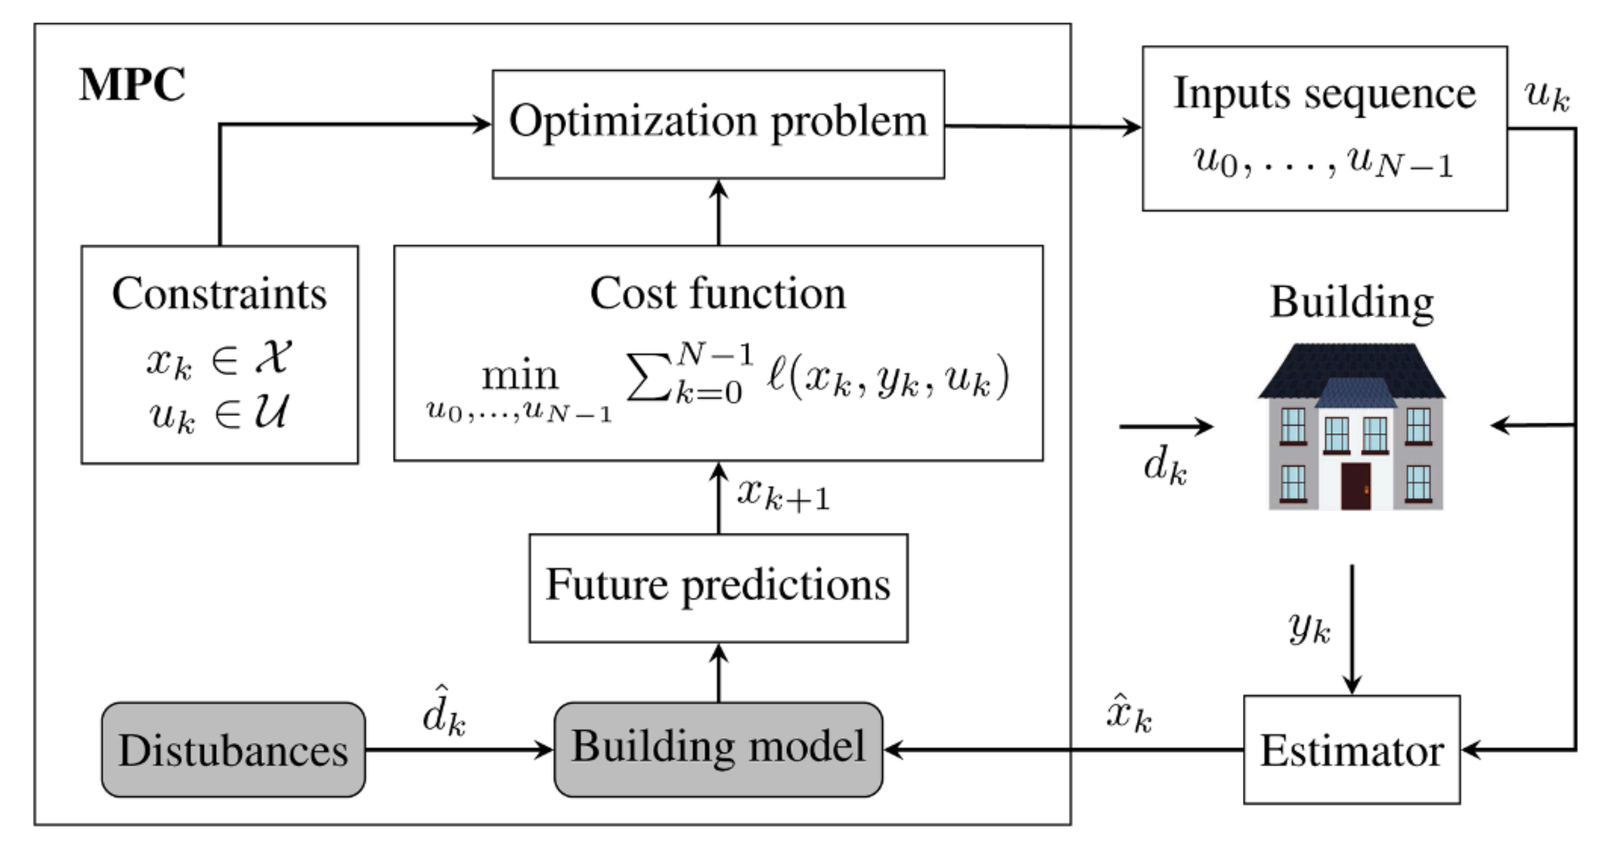
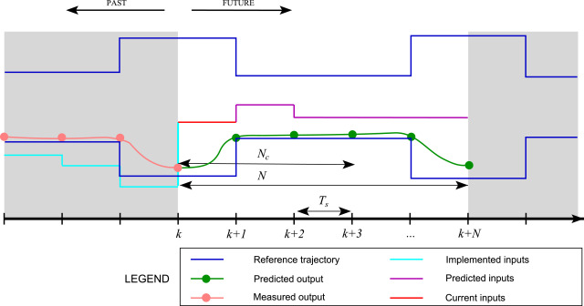
Week 9: Model Predictive Control of Building Energy Systems
Model Predictive Control (MPC) diagram:
Model Predictive Control (MPC) is an advanced control strategy that uses a model of the system to predict future behavior and optimize control inputs by using constrained optimization algorithms. MPC has become popular in industrial control applications due to its ability to handle multivariable systems with constraints on both inputs and outputs.
Ján Drgoňa, et al., All you need to know about model predictive control for buildings, Annual Reviews in Control, 2020
Notes:
Our paper starts with introduction of control theoretic concepts and detailed review of MPC technology
Explaining topics such as: Closed loop diagrams, Principles of predictive control, state estimation, optimization-based control
Components of predictive control: objectives, constraints, models, formulations, uncertainty quantification and mitigation, solution algorithms

Slide 15

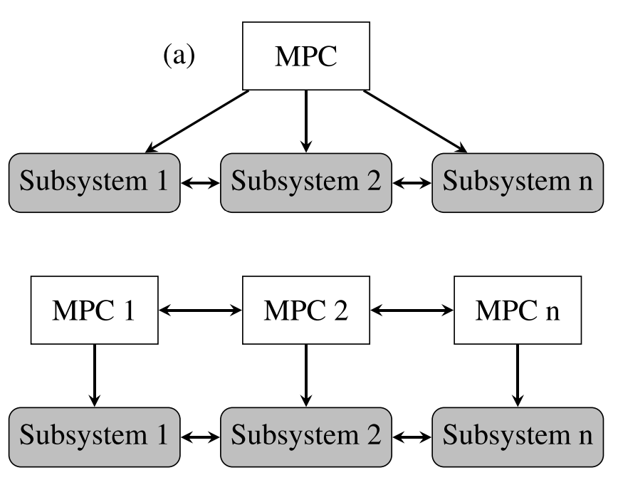
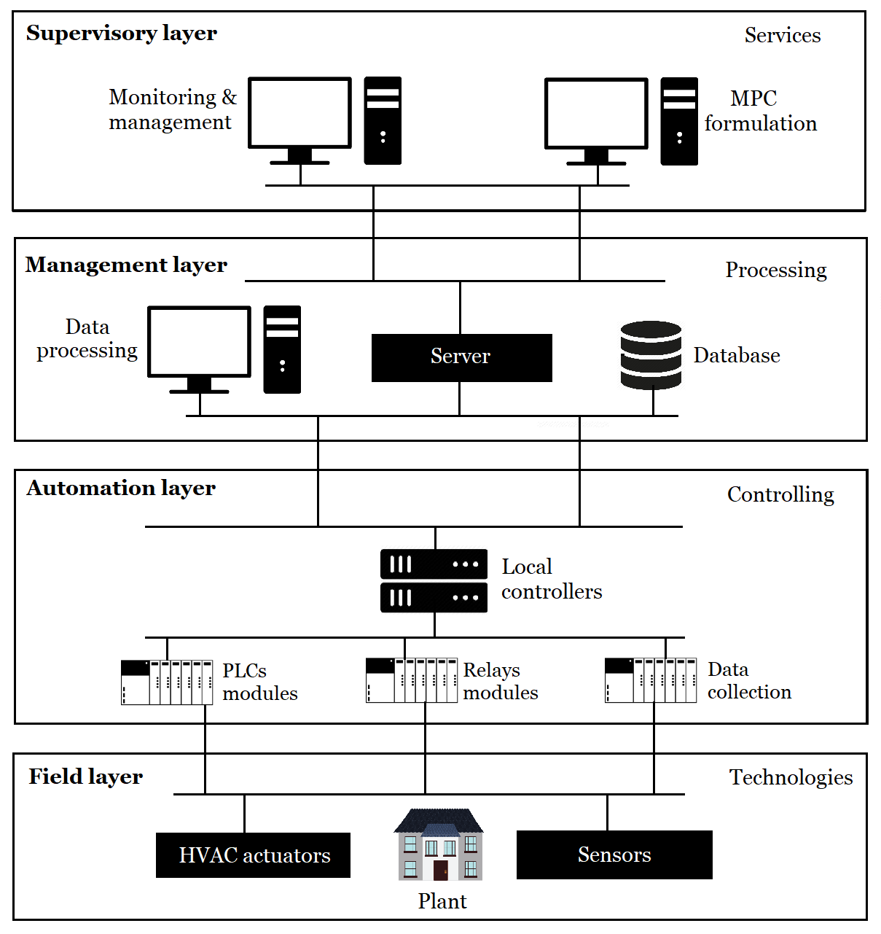





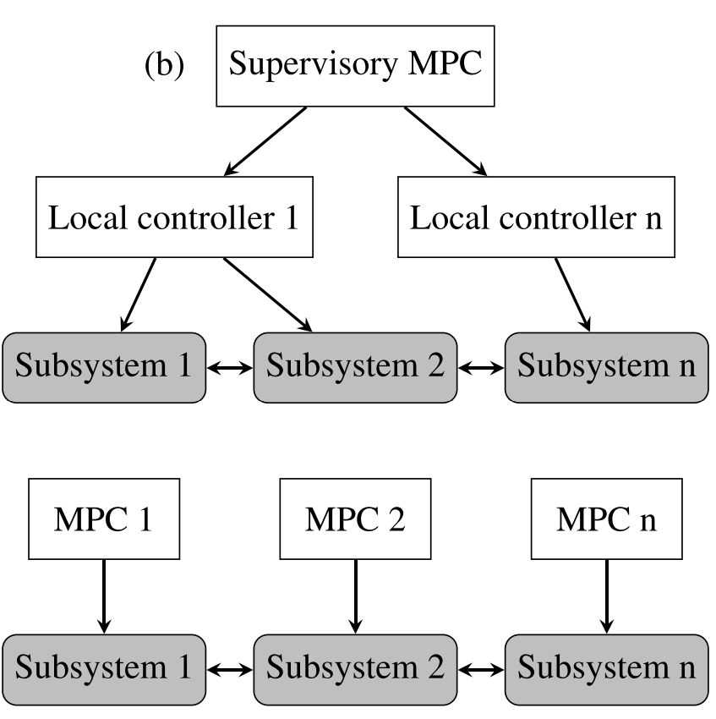



Week 10: Practical Implementation Aspects and High-fidelity Building Emulators
Overview of Software tools
Control Configurations
Communication Architecture
Notes:
Second part of the paper is focused on practical aspects of MPC deployment in practice this includes a comprehensive overview of available SW tools for modeling, control design, solvers, co-simulation, and SW integration tools
We review different control configurations used in industrial systems, together with detailed overview of SCADA architecture components from supervisory to the field level including details on communication protocols, data acquisition and storage, and deployment guidelines

Slide 16
Week 11: Project Presentations and Evaluation
Projects cover 50% of the course grade!
Project progress report 10% - week 8
Project final report 20% - week 10
Project presentation 20% - week 11
Project format.
Project technical report: 3-4 page pdf document including references and figures.
Project presentation: ppt or pdf slides, 15 min time slot per student in week 11.
Admissible topics.
Application of any method (modeling, control, ML) presented in this course on building energy related problems.
Application of AI tools outside of the scope of this course to address modeling, control, and forecasting problems in building energy.

